Slide 1
Welcome to the alien object learning game! In this game, you will learn the names of some alien objects. At the end, you will be tested on what you have learned. Good luck!

Slide 3
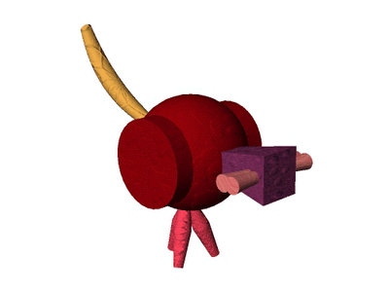

Slide 5
That was a tob.

Slide 7
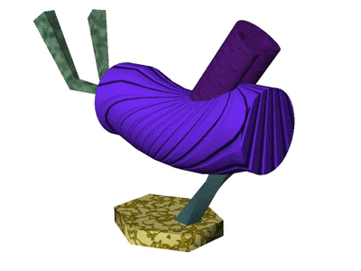

Slide 9
That was a wug.

Slide 11
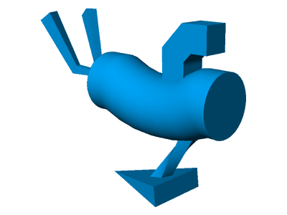

Slide 13
That was a bim.

Slide 15
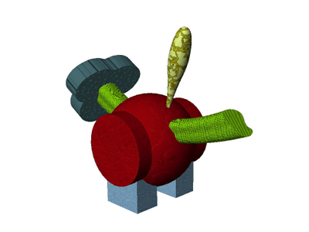

Slide 17
That was a dep.

Slide 19
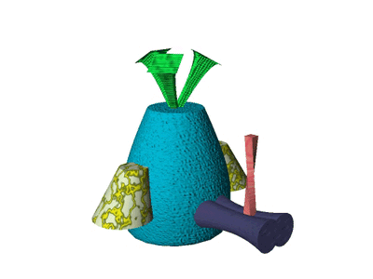

Slide 21
That was a wug.

Slide 23
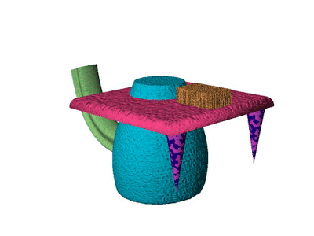

Slide 25
That was a dep.

Slide 27
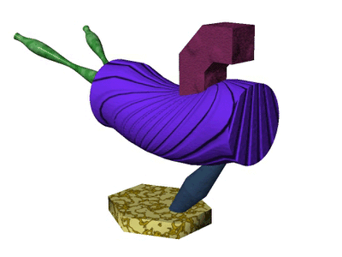

Slide 29
That was a wug.

Slide 31
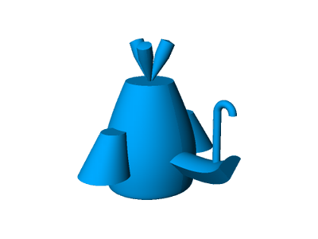

Slide 33
That was a bim.

Slide 35
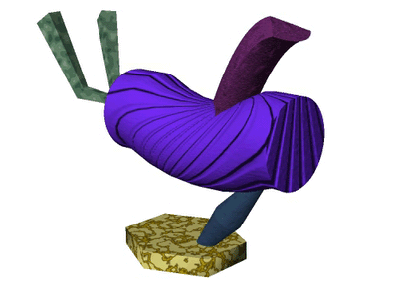

Slide 37
That was a wug.

Slide 39
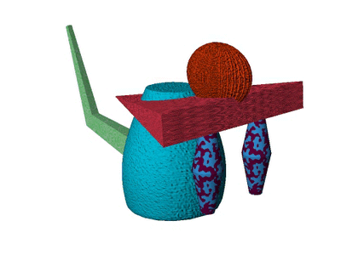

Slide 41
That was a dep.

Slide 43
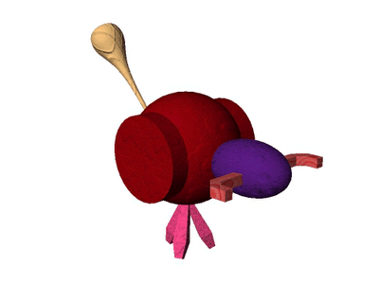

Slide 45
That was a tob.

Slide 47
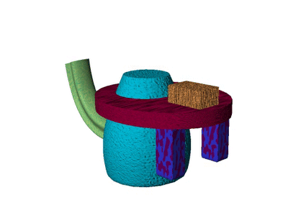

Slide 49
That was a dep.

Slide 51
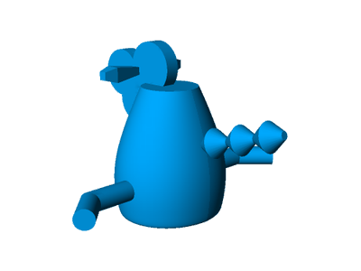

Slide 53
That was a bim.

Slide 55
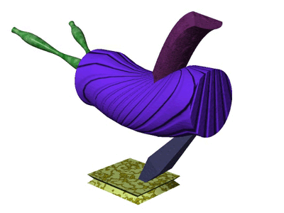

Slide 57
That was a wug.

Slide 59
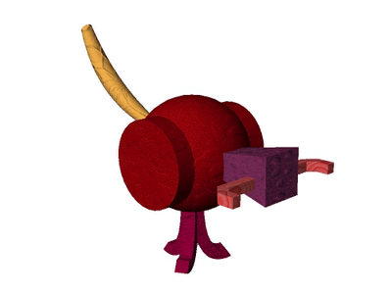

Slide 61
That was a tob.

Slide 63
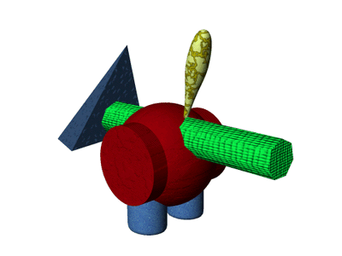

Slide 65
That was a dep.

Slide 67
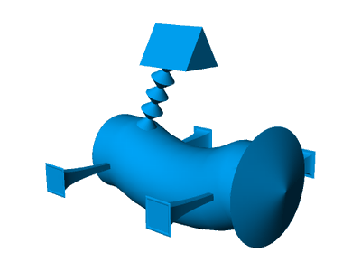

Slide 69
That was a bim.

Slide 71
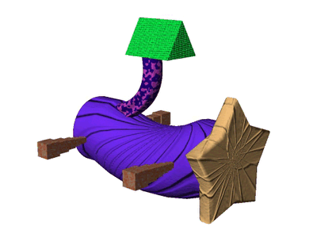

Slide 73
That was a tob.

Slide 75
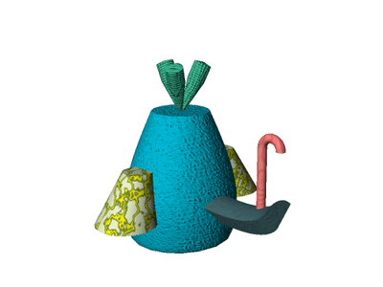

Slide 77
That was a wug.

Slide 79
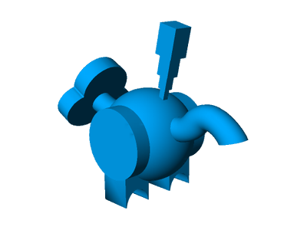

Slide 81
That was a bim.

Slide 83
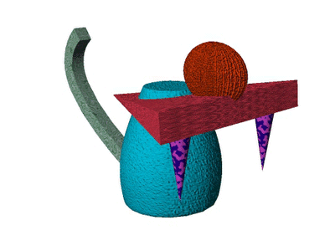

Slide 85
That was a dep.

Slide 87
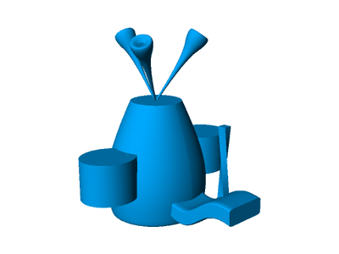

Slide 89
That was a bim.

Slide 91
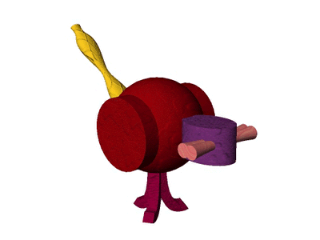

Slide 93
That was a tob.

Slide 95
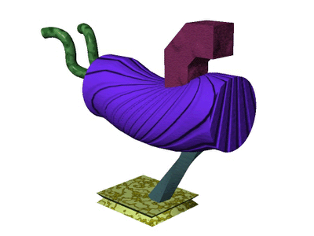

Slide 97
That was a wug.

Slide 99
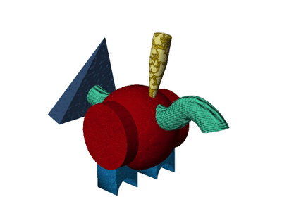

Slide 101
That was a dep.

Slide 103
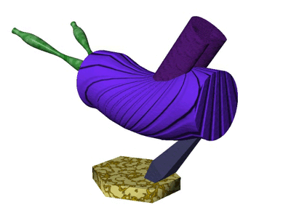

Slide 105
That was a wug.

Slide 107
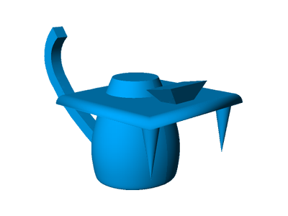

Slide 109
That was a bim.

Slide 111
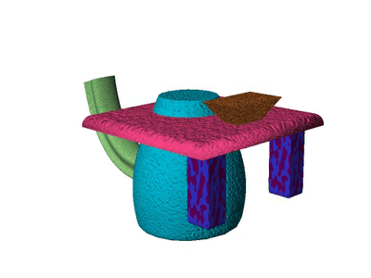

Slide 113
That was a dep.

Slide 115
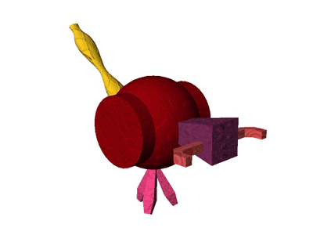

Slide 117
That was a tob.

Slide 119
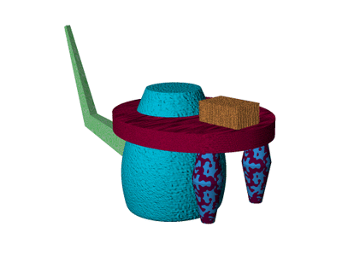

Slide 121
That was a dep.

Slide 123
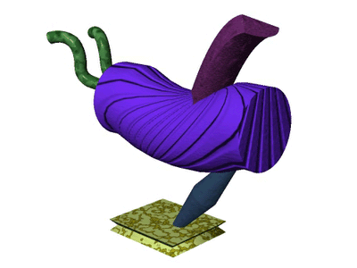

Slide 125
That was a wug.

Slide 127
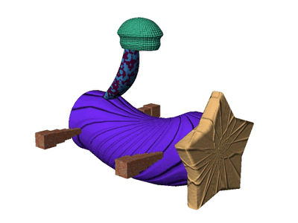

Slide 129
That was a tob.

Slide 131
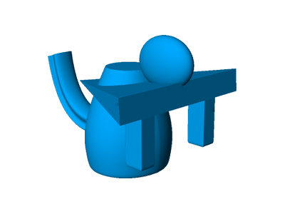

Slide 133
That was a bim.

Slide 135
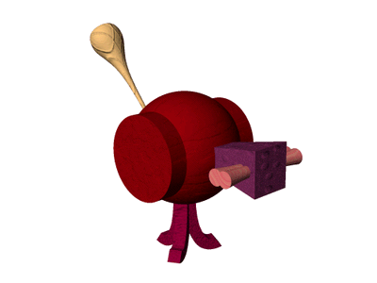

Slide 137
That was a tob.

Slide 139
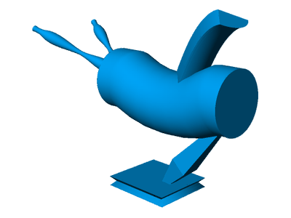

Slide 141
That was a bim.

Slide 143
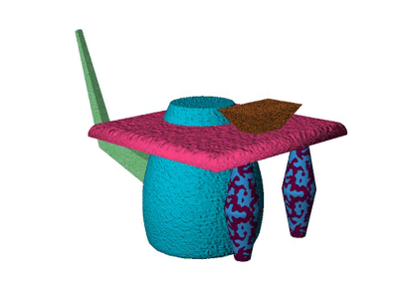

Slide 145
That was a dep.

Slide 147
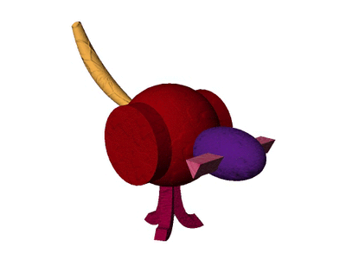

Slide 149
That was a tob.

Slide 151
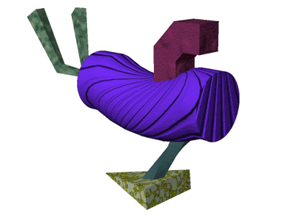

Slide 153
That was a wug.

Slide 155
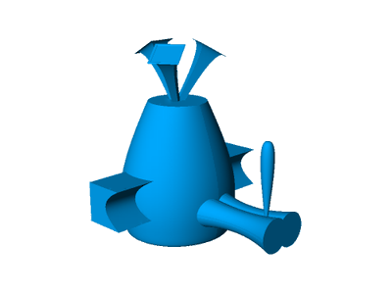

Slide 157
That was a bim.

Slide 159
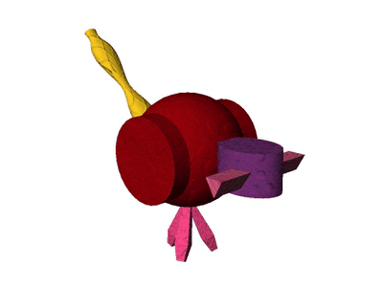

Slide 161
That was a tob.

Slide 163
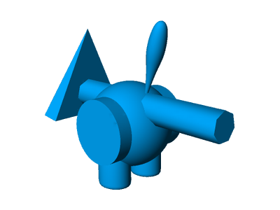

Slide 165
That was a bim.

Slide 167
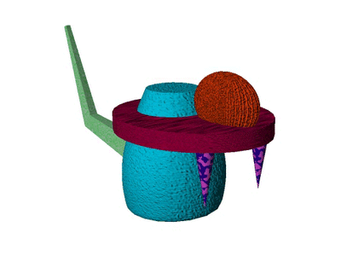

Slide 169
That was a dep.

Slide 171
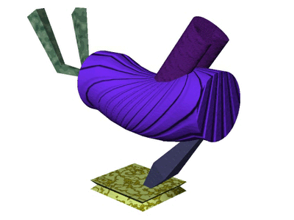

Slide 173
That was a wug.

Slide 175
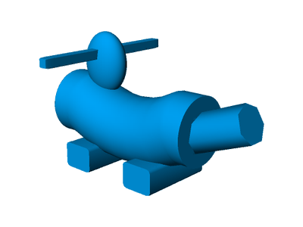

Slide 177
That was a bim.

Slide 179
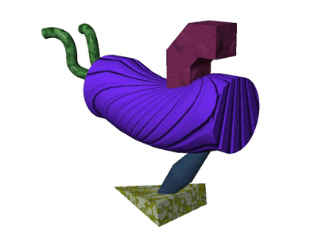

Slide 181
That was a wug.

Slide 183
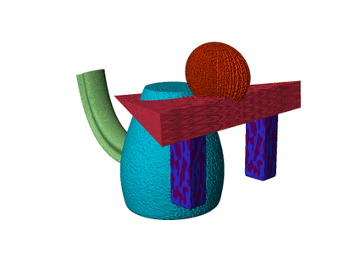

Slide 185
That was a dep.

Slide 187
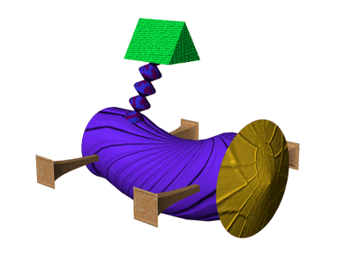

Slide 189
That was a tob.

Slide 191
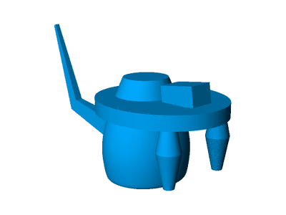

Slide 193
That was a bim.

Slide 195
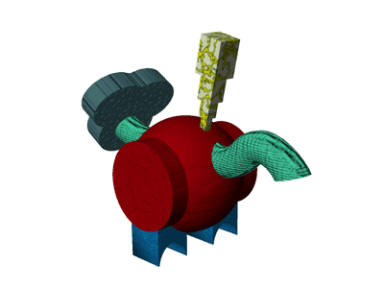

Slide 197
That was a dep.

Slide 199
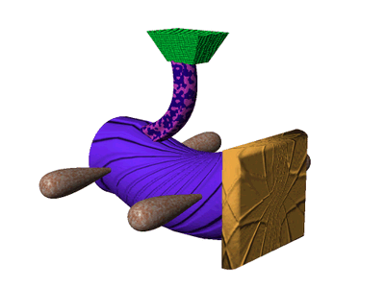

Slide 201
That was a tob.

Slide 203


Slide 205
That was a bim.

Slide 207


Slide 209
That was a wug.

Slide 211


Slide 213
That was a tob.

Slide 215


Slide 217
That was a dep.

Slide 219


Slide 221
That was a bim.

Slide 223


Slide 225
That was a tob.

Slide 227


Slide 229
That was a dep.

Slide 231


Slide 233
That was a wug.

Slide 235


Slide 237
That was a dep.

Slide 239


Slide 241
That was a wug.

Slide 243


Slide 245
That was a bim.

Slide 247


Slide 249
That was a dep.

Slide 251


Slide 253
That was a bim.

Slide 255


Slide 257
That was a tob.

Slide 259


Slide 261
That was a wug.

Slide 263


Slide 265
That was a dep.

Slide 267


Slide 269
That was a tob.

Slide 271


Slide 273
That was a wug.

Slide 275


Slide 277
That was a tob.

Slide 279


Slide 281
That was a dep.

Slide 283


Slide 285
That was a wug.

Slide 287


Slide 289
That was a bim.

Slide 291


Slide 293
That was a wug.

Slide 295


Slide 297
That was a dep.

Slide 299


Slide 301
That was a tob.

Slide 303


Slide 305
That was a bim.

Slide 307


Slide 309
That was a tob.

Slide 311


Slide 313
That was a wug.

Slide 315


Slide 317
That was a bim.

Slide 319


Slide 321
That was a tob.

Slide 323
End of training.
Please get the experimenter.

